Slide 1

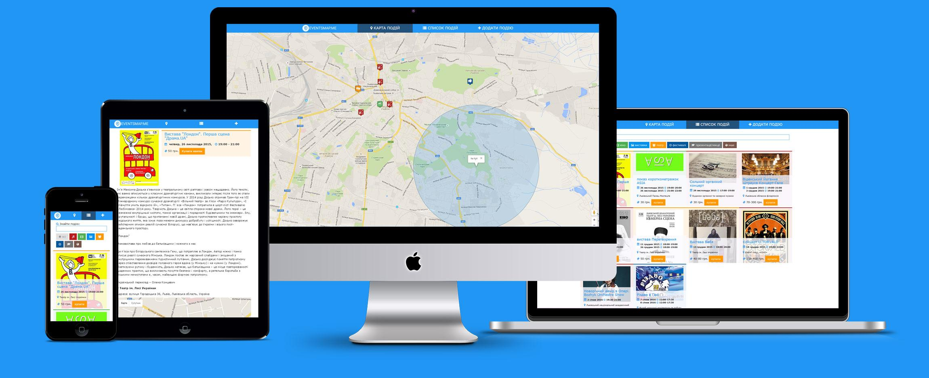
find events around your location

Slide 2

Volodymyr Pits
front-end developer

Slide 3
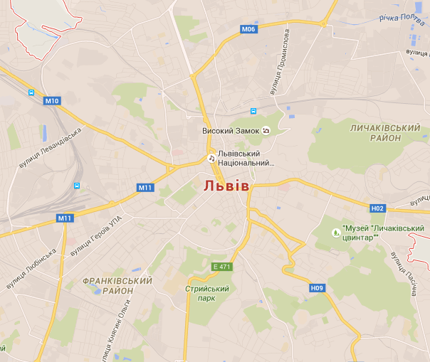

Idea
Web service which help find interesting events using your geolocation and show them on map
event 1
event 2
event 3
event 4
+
+
=

Slide 4
Realization
Single Page Application (SPA) with integration Google Maps API

Slide 5


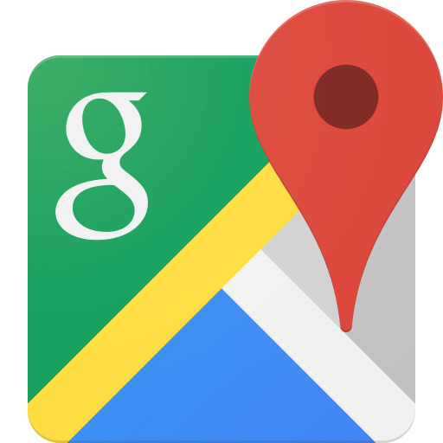


Used technologies

Slide 6
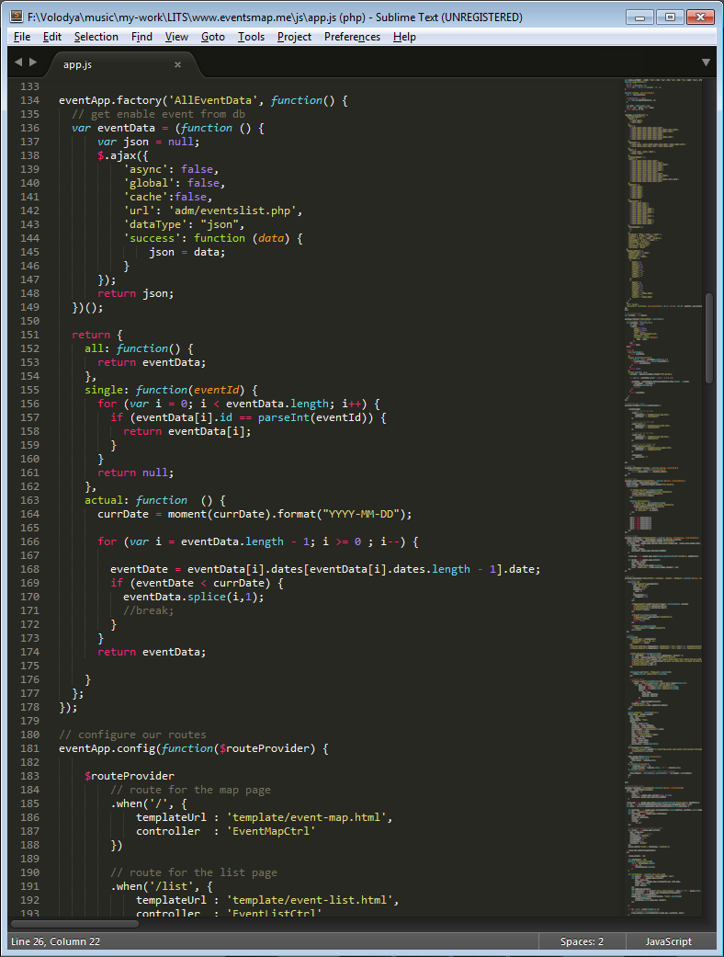
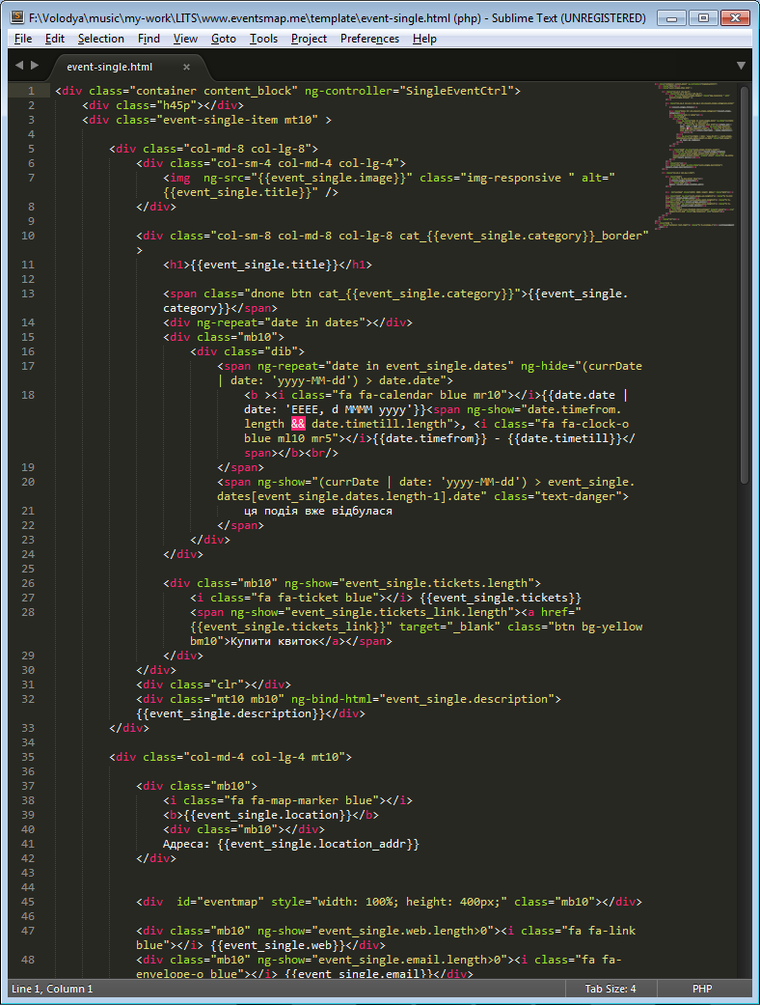
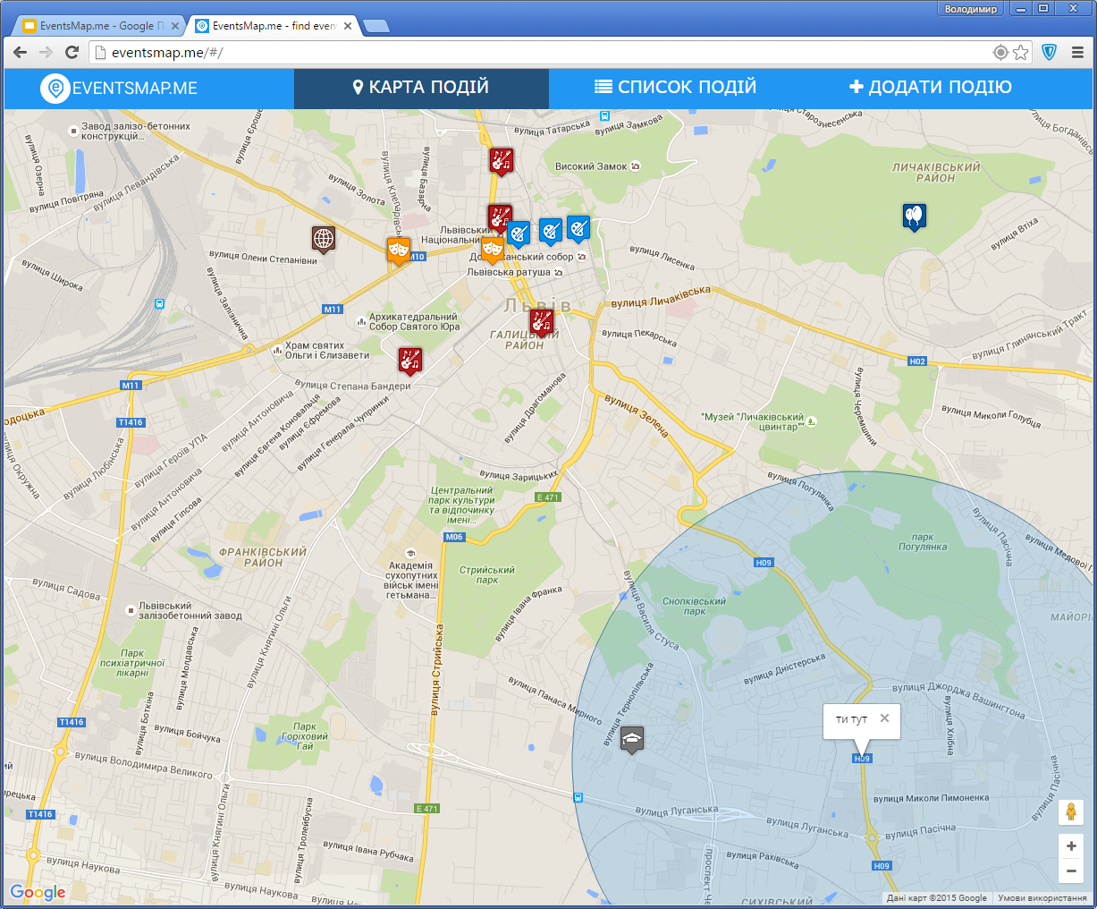
Realization

Slide 7
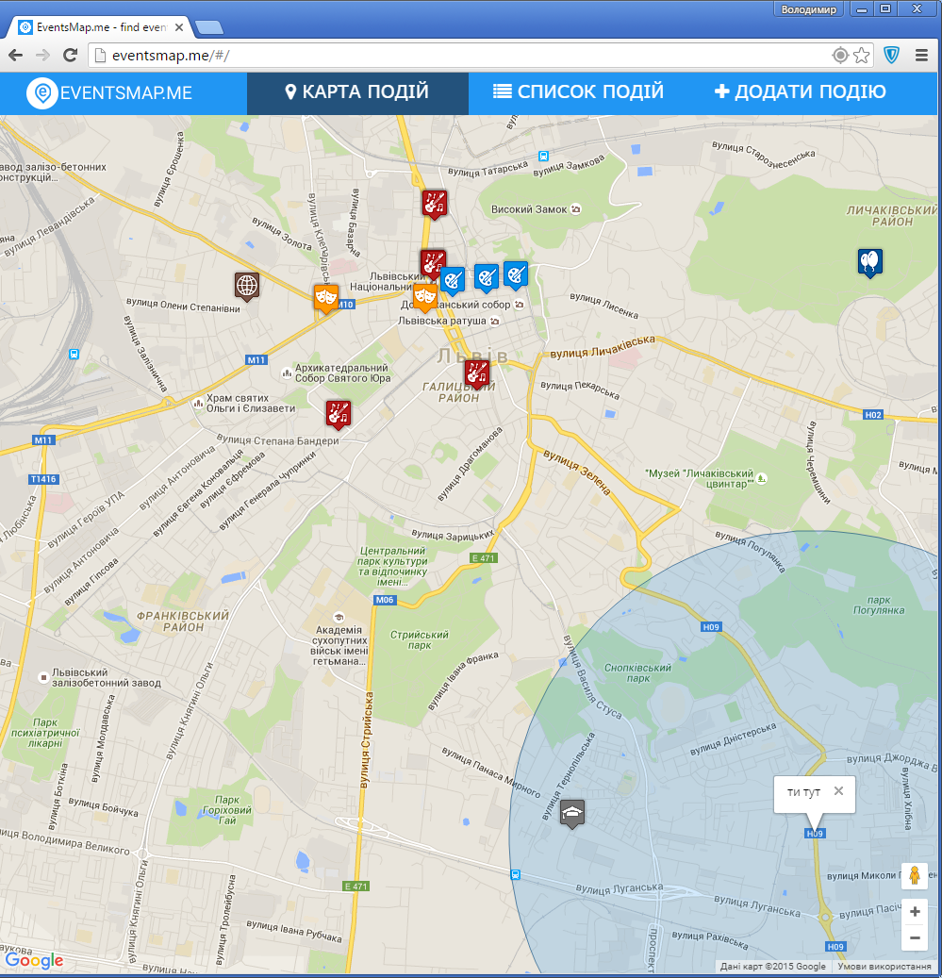
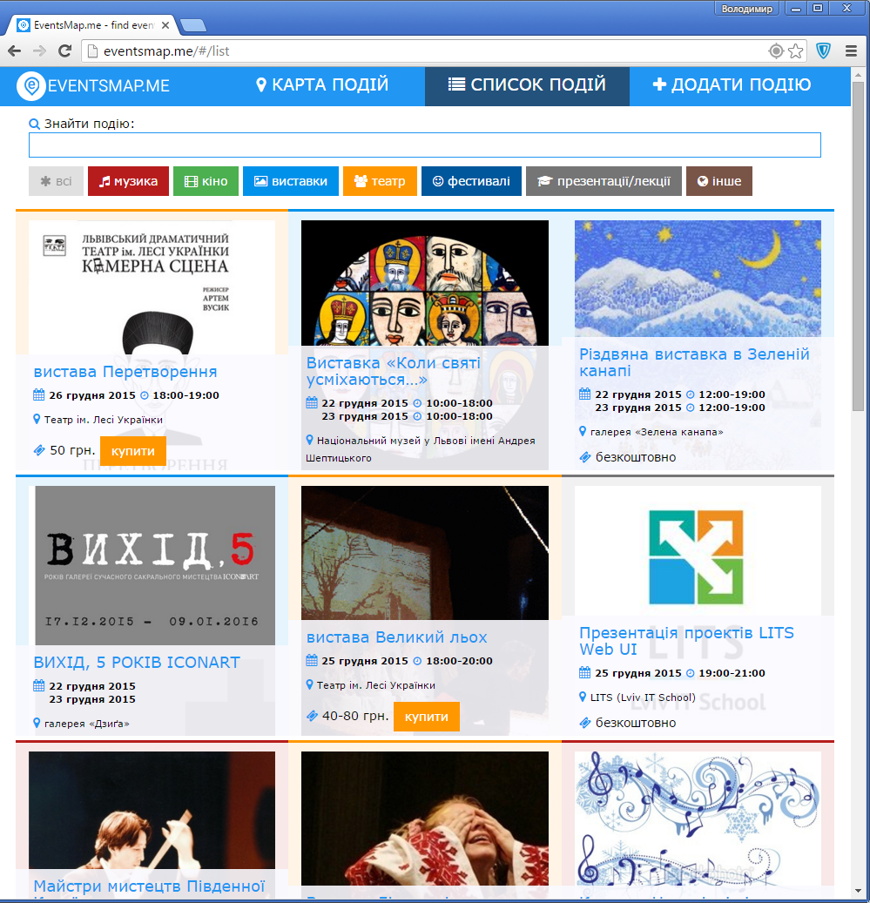
Realization

Slide 8
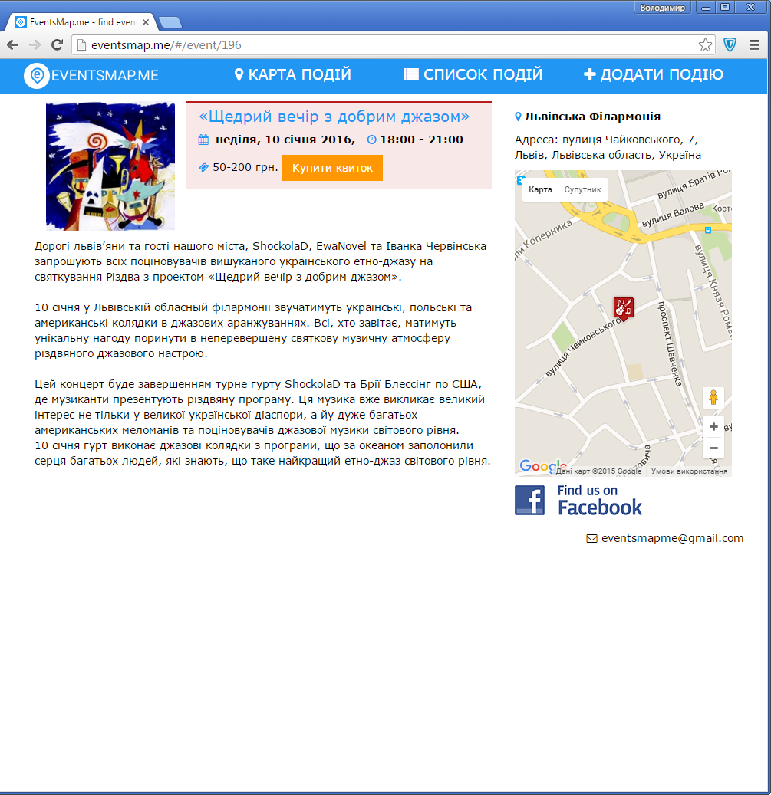
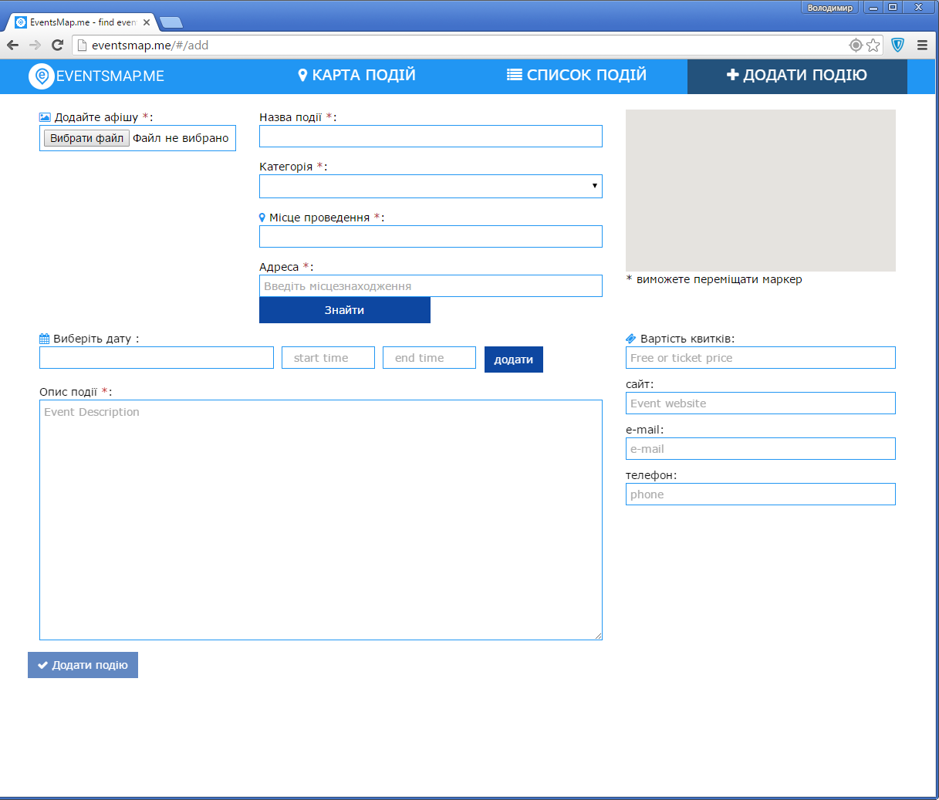
Realization

Slide 9
Project development
Expansion functionality:
login/registration using social network
add events to Favorites
Visit events and find out friends who are attending this event
add Facebook event
Business model:
monetization through partnerships ticket sales
paid advertising (Top events)
branding
other (barter, information support, etc.)

Slide 10
Thank you!
contacts:
skype: volodymyrpits
e-mail: vlodkopits@gmail.com
linkedin: https://ua.linkedin.com/in/vpits

